Slide 1
PROGRAMMING IN PYTHON

Slide 2
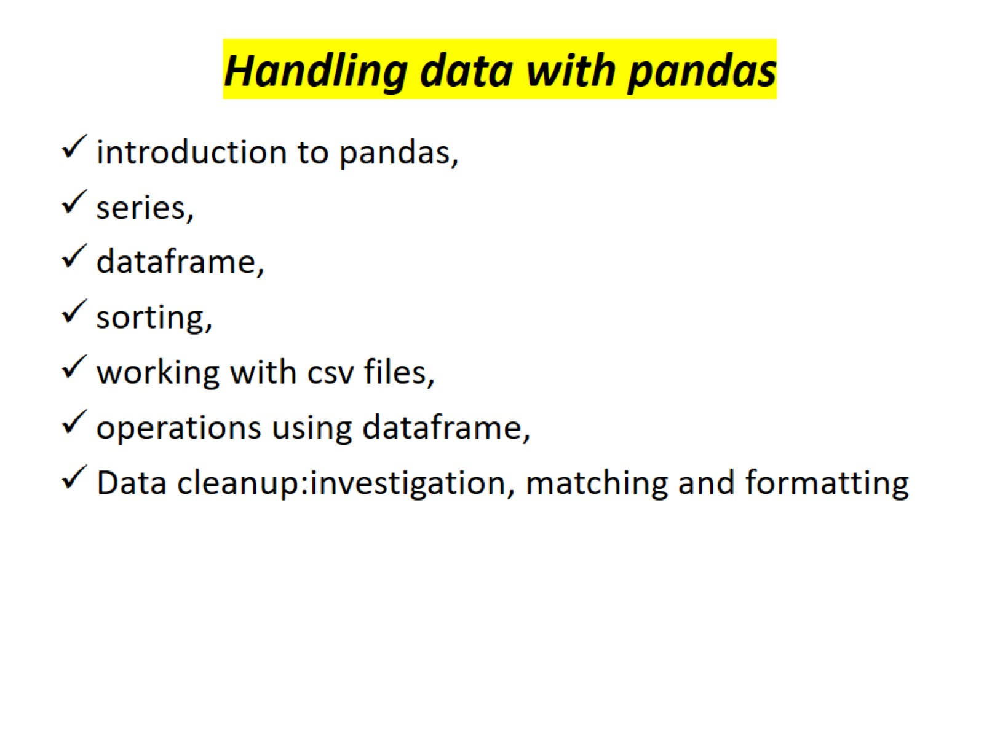
Handling data with pandas

Slide 3
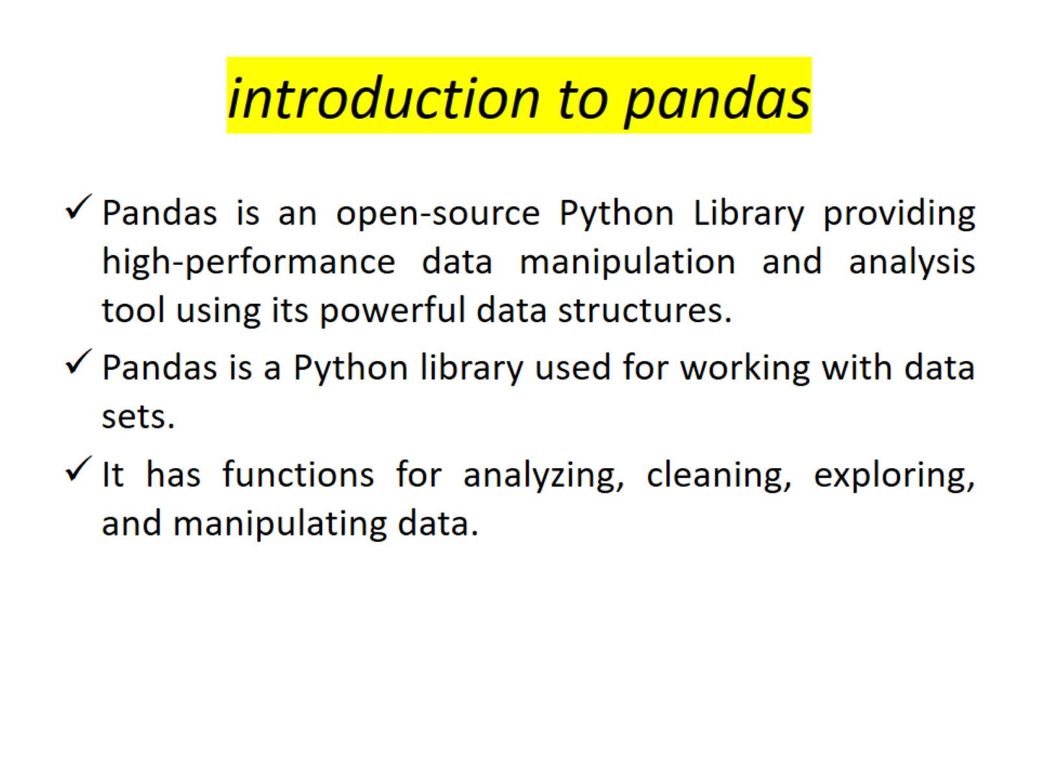
introduction to pandas

Slide 4
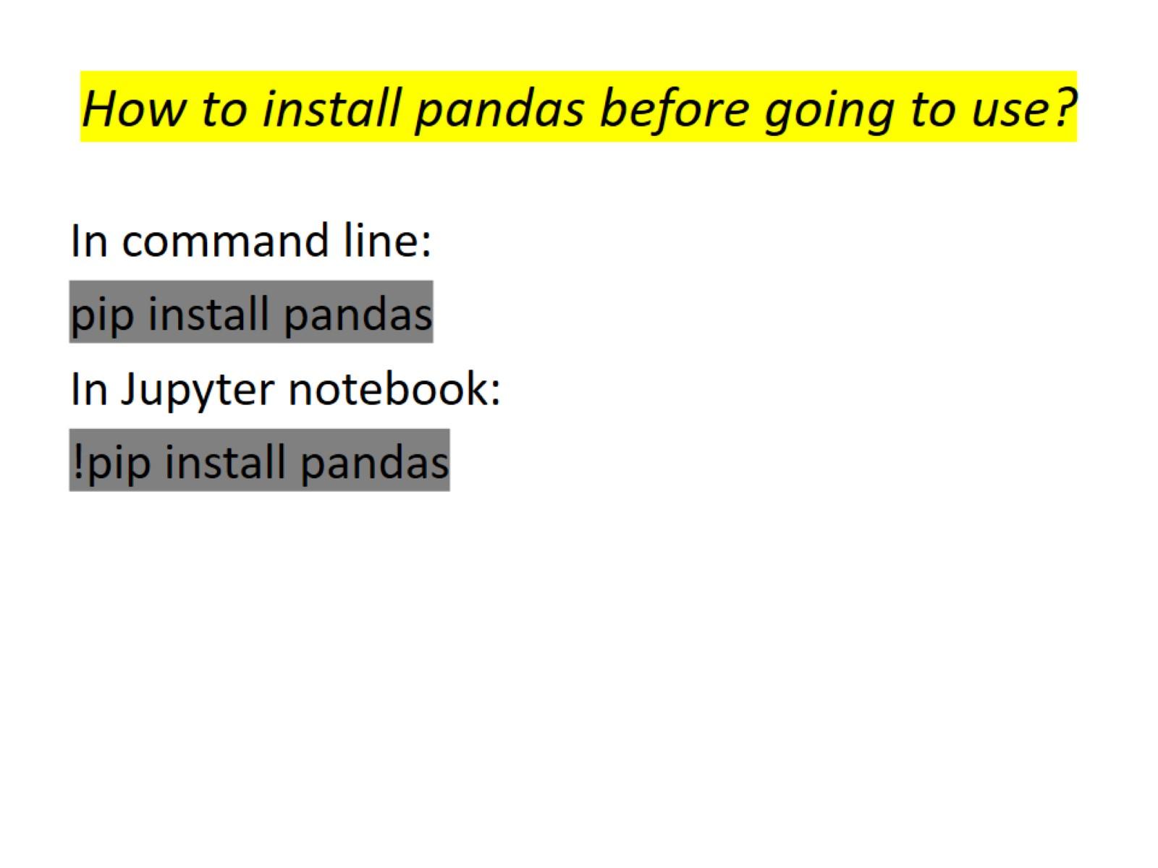
How to install pandas before going to use?

Slide 5
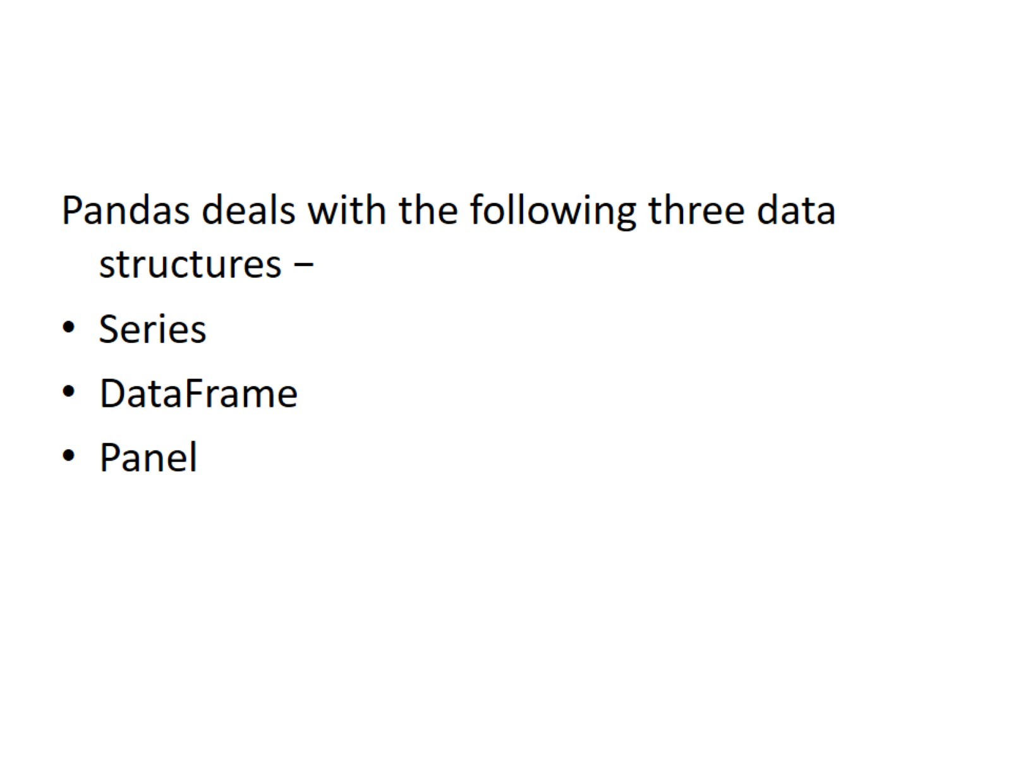

Slide 6
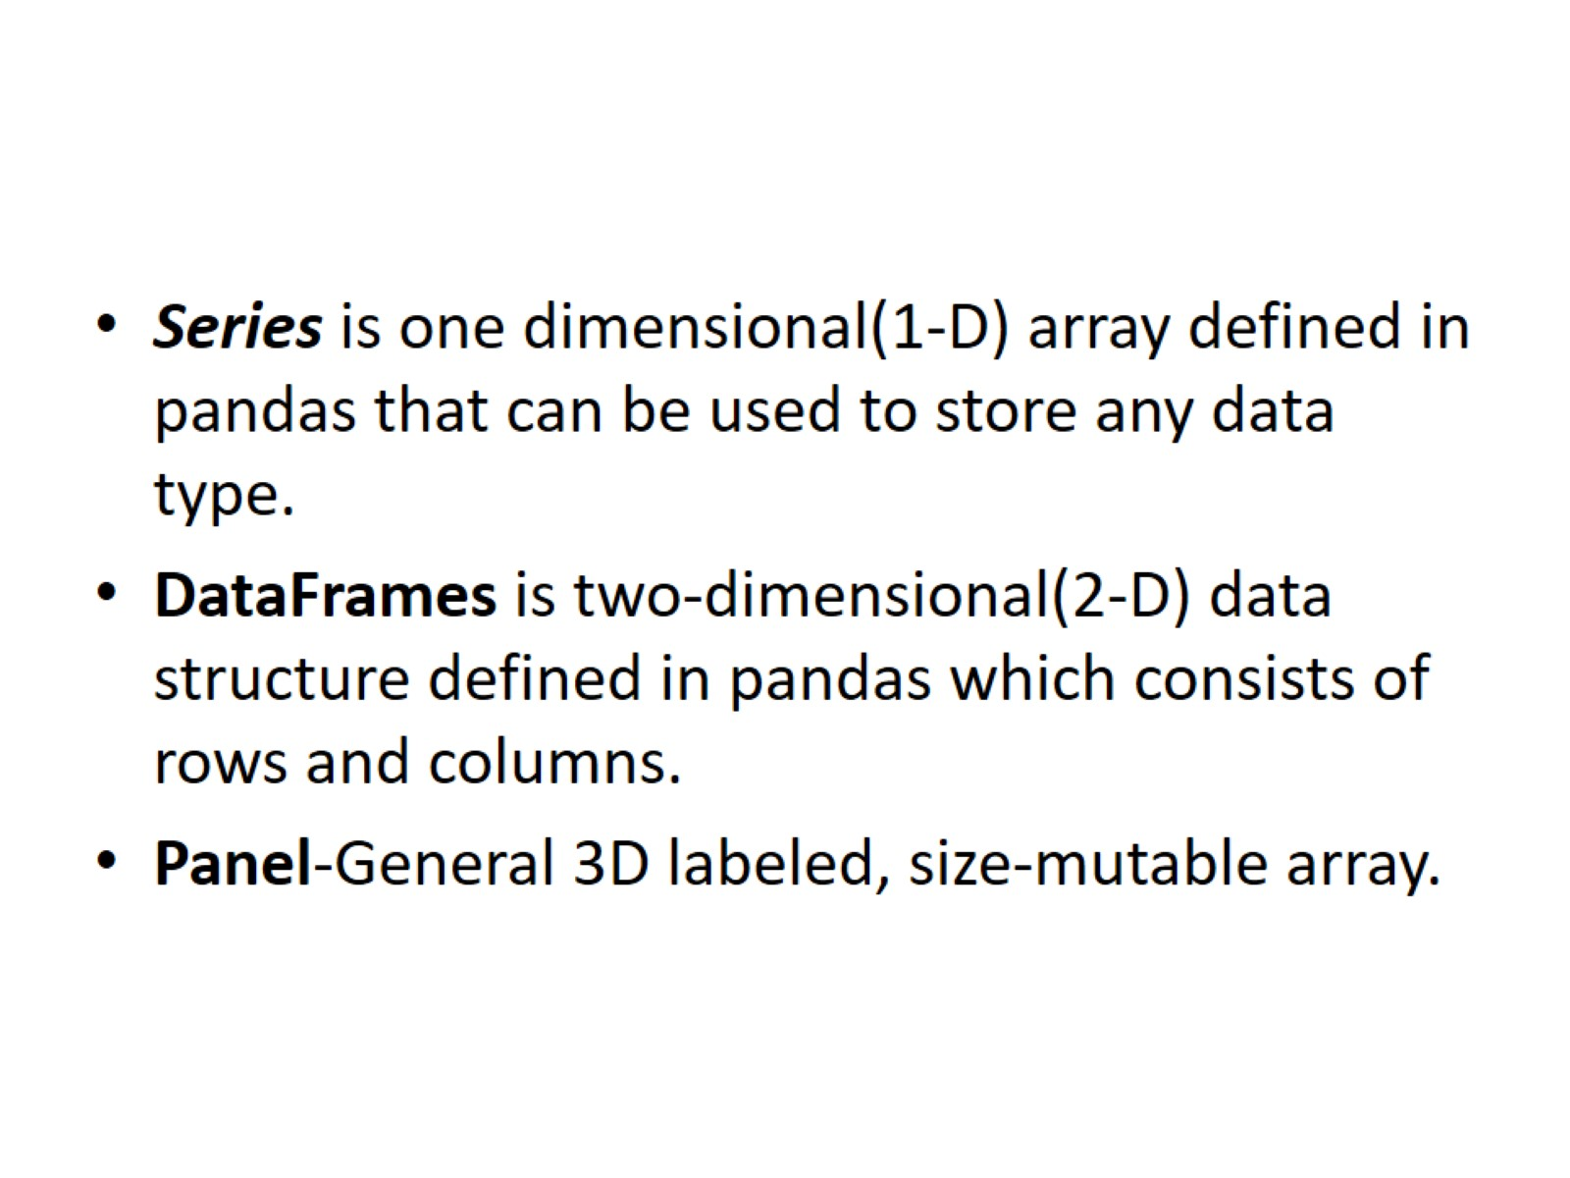

Slide 7
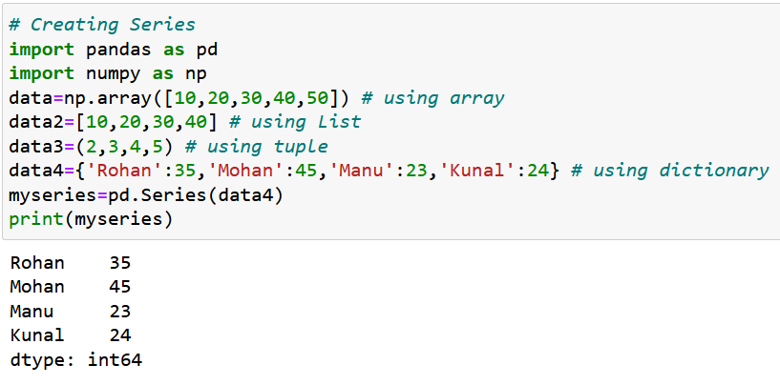
Series
Create a Series from ndarray,list,tuple,dictionary

Slide 8
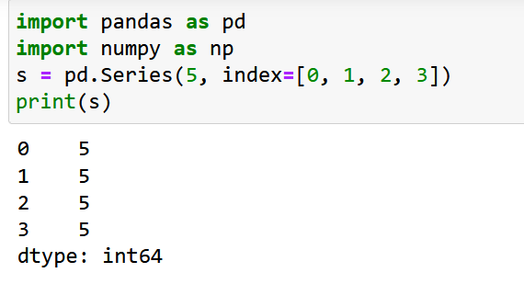
Create a Series from Scalar
If data is a scalar value, an index must be provided. The value will be repeated to match the length of index

Slide 9
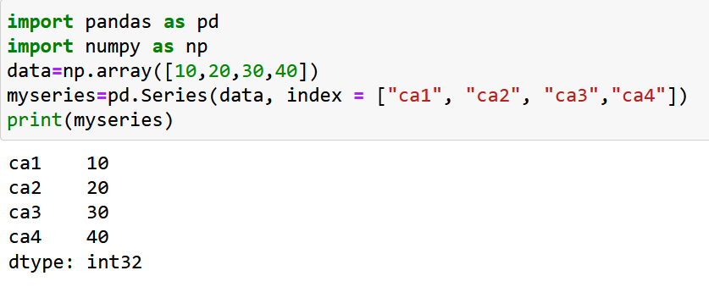
Labels
If nothing else is specified, the values are labeled with their index number. First value has index 0, second value has index 1 etc.
Create Labels
With the index argument, you can name your own labels.

Slide 10
Data frame
A Data frame is a two-dimensional data structure, i.e., data is aligned in a tabular fashion in rows and columns.
DataFrame can be created using :Lists,dict,Series,Numpy ndarrays another DataFrame
DataFrame can be created using the following constructor −
pandas.DataFrame( data, index, columns, dtype, copy)
data can be Lists,dict,Series,Numpy ndarrays another DataFrame
index: For the row labels
columns: For column labels
dtype: data type of each column
copy: copying of data

Slide 11
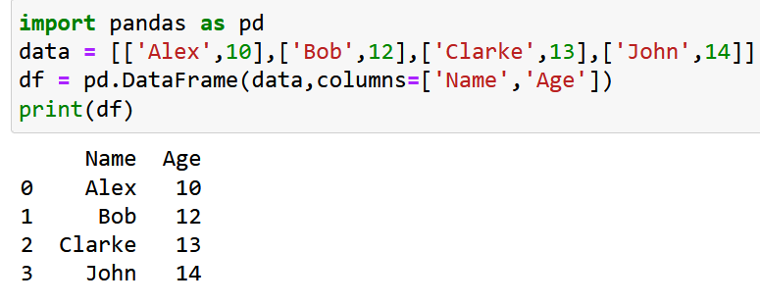
Name | Age
Alex | 10
Bob | 12
Clarke | 13
John | 14

Slide 12
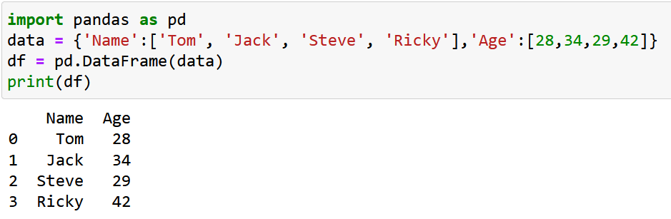
Create a DataFrame from Dictionary of Lists

Slide 13
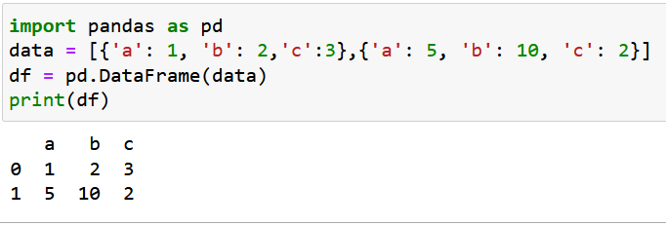
Create a DataFrame from List of Dicts

Slide 14
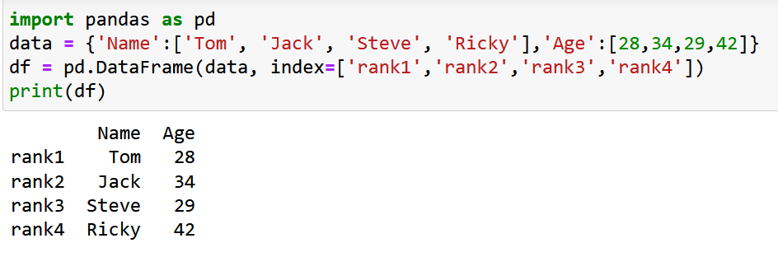
create an indexed DataFrame

Slide 15
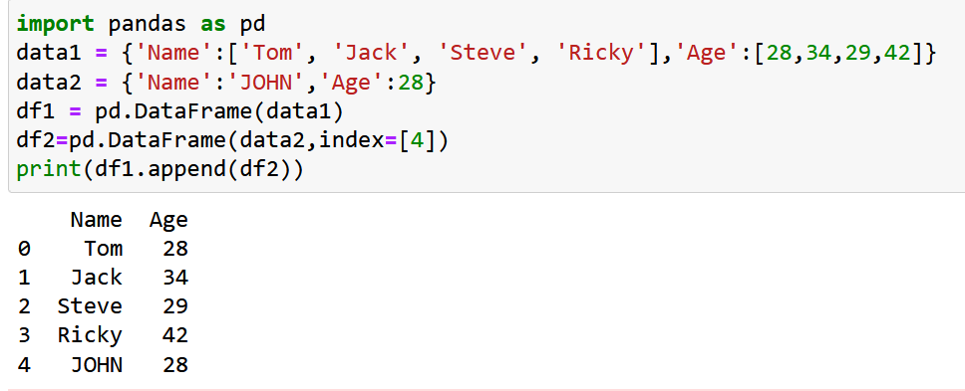
Addition of Rows
Add new rows to a DataFrame using the append function. This function will append the rows at the end.

Slide 16
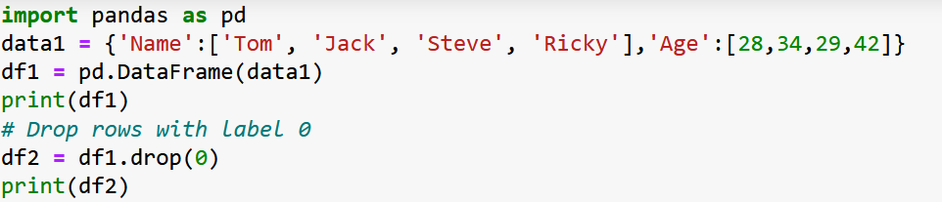
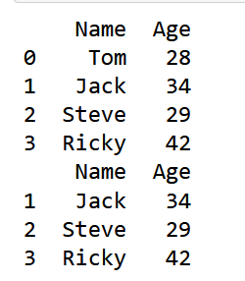
Deletion of Rows
Use index label to delete or drop rows from a DataFrame. If label is duplicated, then multiple rows will be dropped.

Slide 17
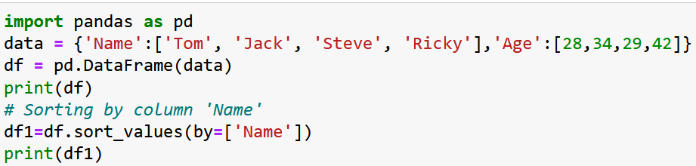
Sorting Pandas Data Frame
sort_values() can sort the data frame in Ascending or Descending order.
Sorting the Data frame in Ascending order

Slide 18
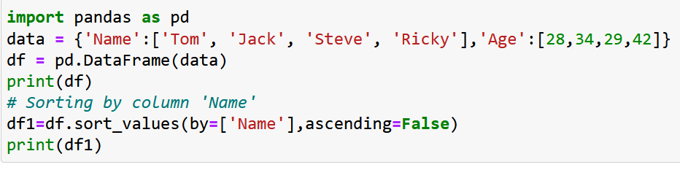
Sorting the Data frame in Descending order

Slide 19
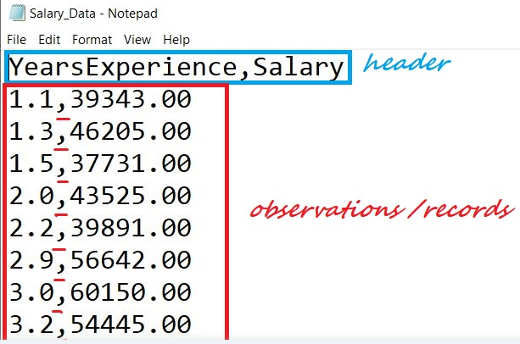
Working with csv files
CSV stands for “Comma Separated Values.” It is the simplest form of storing data in tabular form as plain text.
Structure of CSV:
We have a file named “Salary_Data.csv.”
The first line of a CSV file is the header
and contains the names of the fields/features. After the header, each line of the file is an observation/a record. The values of a record are separated by “comma.”

Slide 20
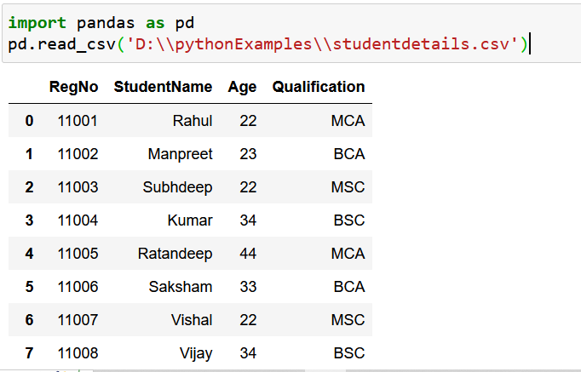
Read CSV Files
Opening a local CSV file
Use read_csv()

Slide 21
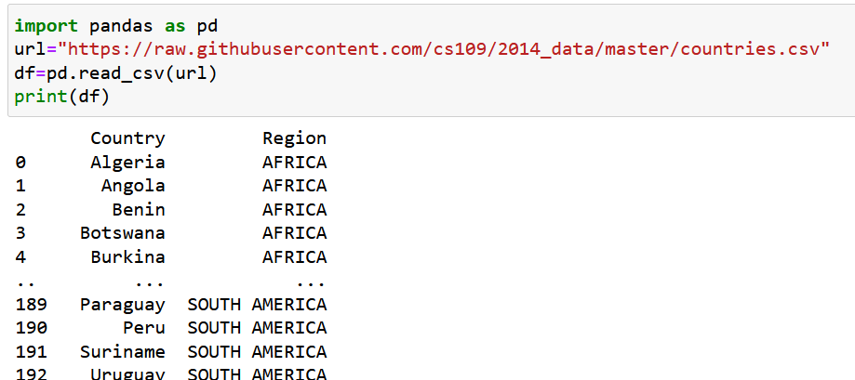
Opening a CSV file from a URL
If you have a large DataFrame with many rows, Pandas will only return the first 5 rows, and the last 5 rows

Slide 22
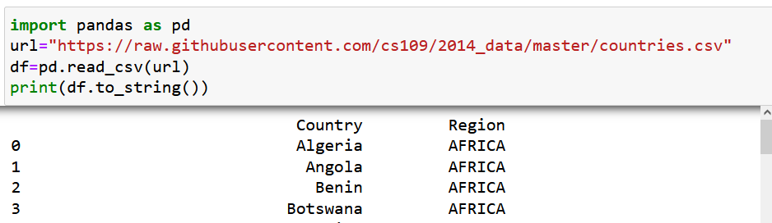
DataFrame with the to_string() method
It will display all rows and cols

Slide 23
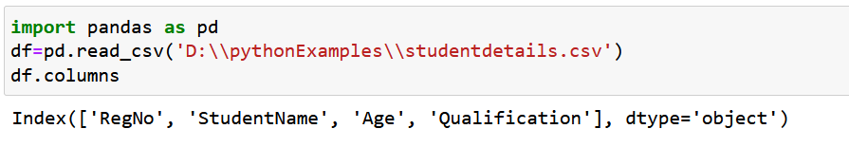
DataFrame.columns
DataFrame.columns attribute to return the column labels of the given dataframe

Slide 24
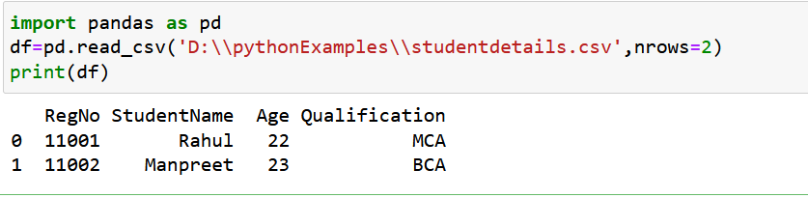
nrows
Using nrows keyword you can display no. of rows according to your choice.

Slide 25
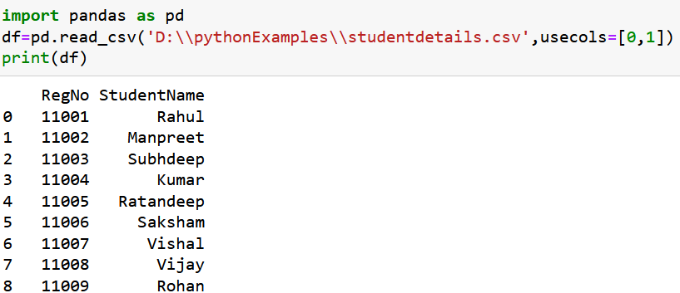
usecols
Using usecols keyword you can display no. of columns according to your choice.

Slide 26
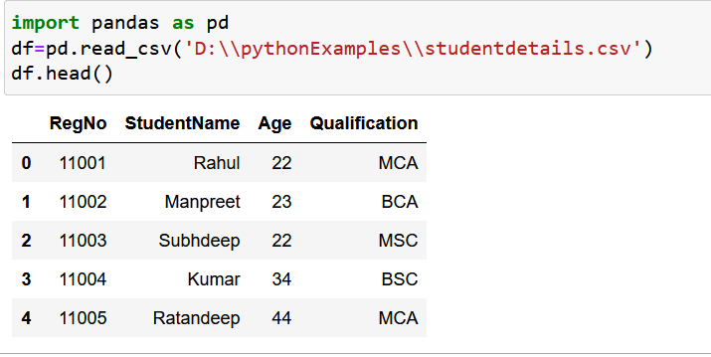
head()
DataFrame.head(): use to display top 5 rows

Slide 27
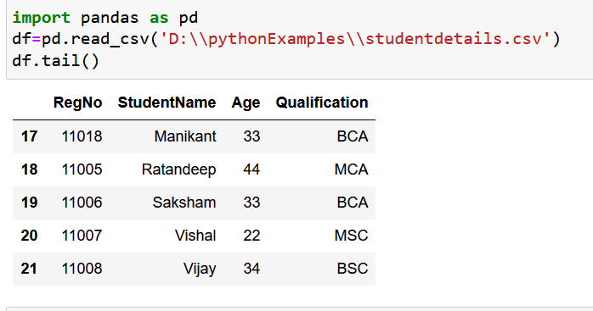
tail()
DataFrame.tail(): use to display bottom 5 rows

Slide 28
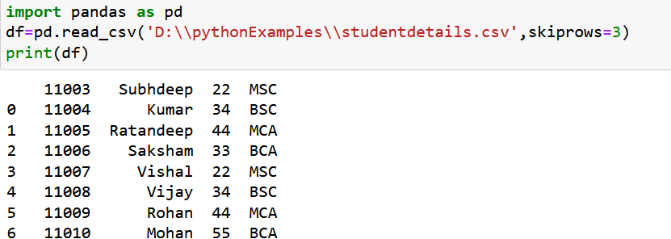
skiprows
If you want to skip rows from your dataset then use argument skiprows

Slide 29
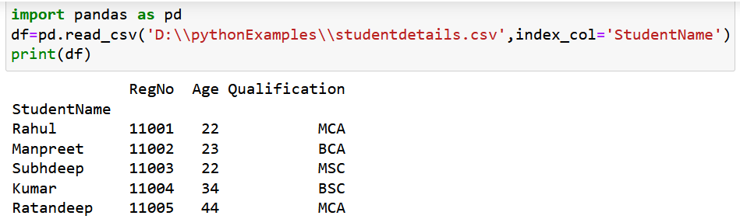
index_col
If you want to change index with any column name then use argument index_col

Slide 30
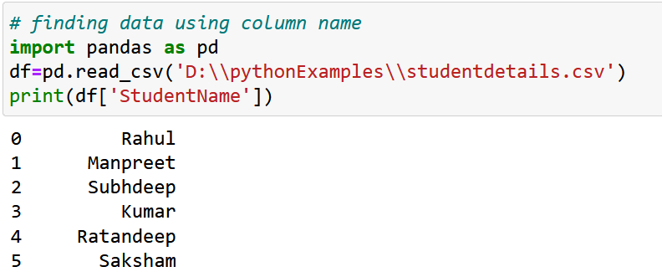
finding data using column name

Slide 31
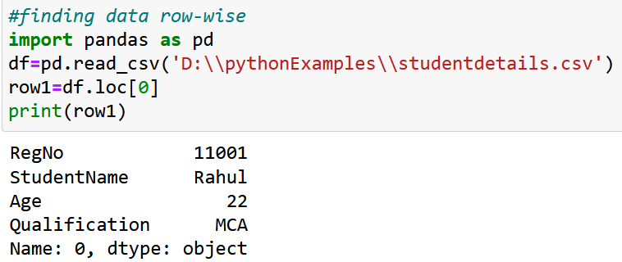
finding data row-wise

Slide 32
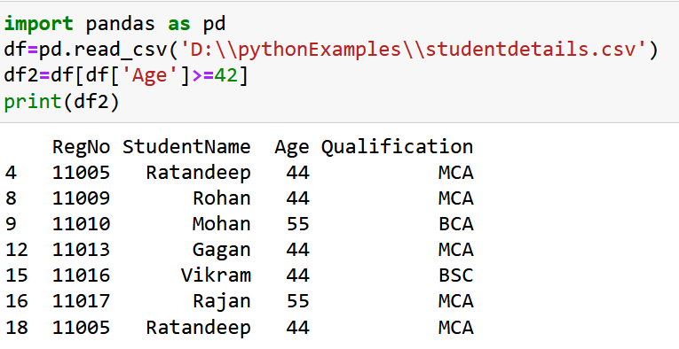
Apply conditions in dataframe

Slide 33
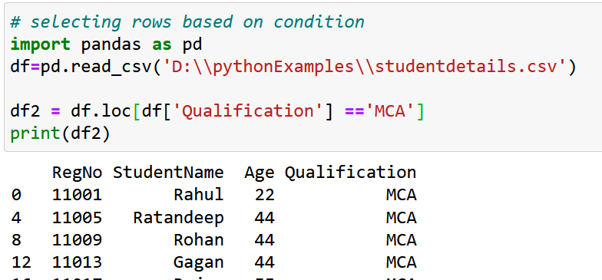
selecting rows based on condition

Slide 34
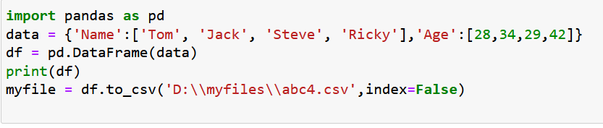
Create CSV file using to_csv()

Slide 35
Data cleaning
When working with multiple data sources, there are many chances for data to be incorrect, duplicated, or mislabeled In such situation your decision can be wrong during data analysis.
Data cleaning is the process of changing or eliminating garbage, incorrect, duplicate, corrupted, or incomplete data in a dataset.
So, A data set can contain:
Empty cells
Data in wrong format
Wrong data and
Duplicates

Slide 36
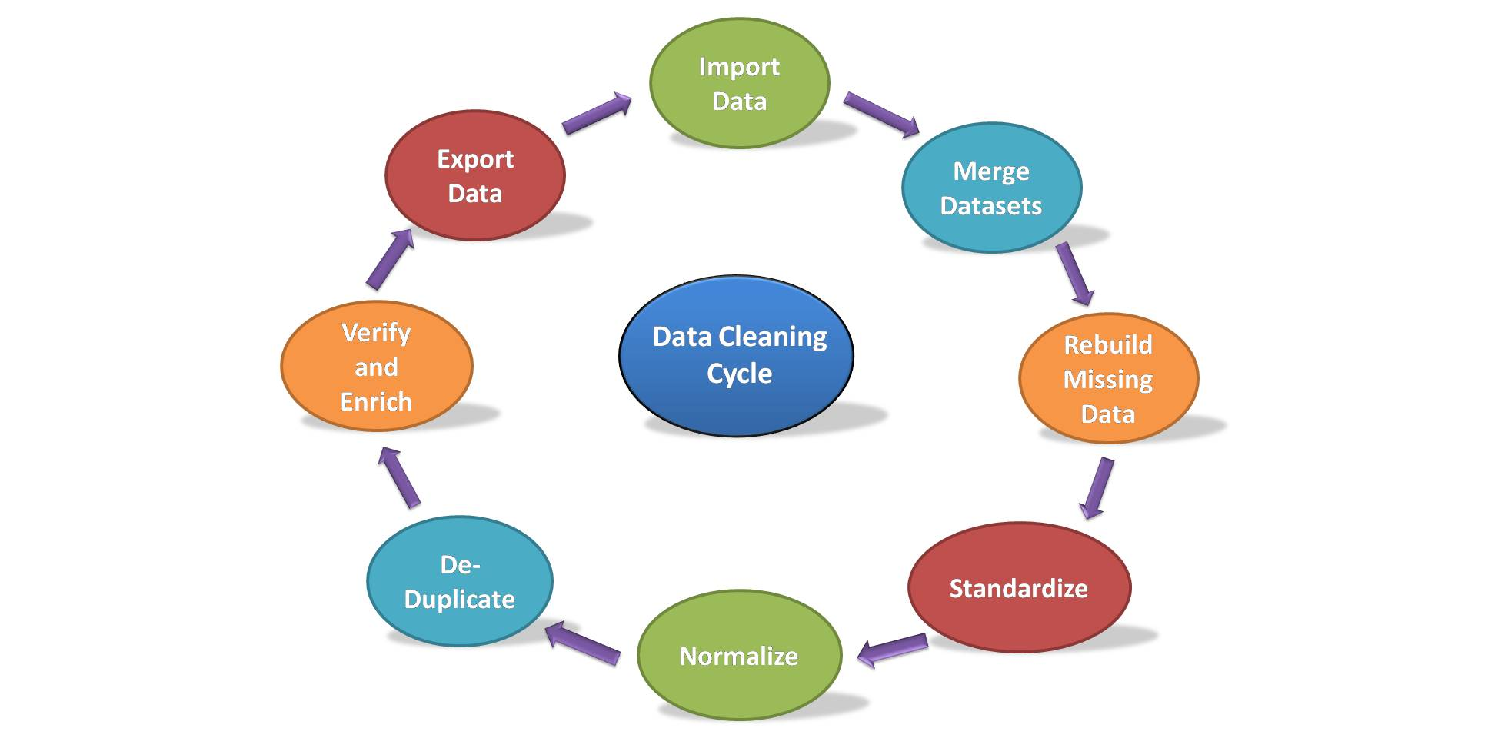

Slide 37
Steps to Cleaning Data:
Import Dataset : To import the dataset we use the read_csv() function of pandas and store it in the DataFrame named as data.
Merge Dataset: Merging the dataset is the process of combining two datasets in one, and line up rows based on some particular or common property for data analysis. We can do this by using the merge() function of the dataframe.
Rebuild Missing Data: To find and fill the missing data in the dataset we will use another function. There are 4 ways to find the null values if present in the dataset.
Using isnull() function
Using isna() function
Using isna().any()
Using isna(). sum()
Using isna().any().sum()

Slide 38
To read data from a file
import pandas as pd
df = pd.read_csv("C:\\Users\\SUMIT\\OneDrive\\Desktop\\Book1.csv")
maxClm = df[df['salary']>2000]
print(maxClm)

Slide 39
To delete data from database file
#drop method
import pandas as pd
data = pd.read_csv("C:\\Users\\SUMIT\\OneDrive\\Desktop\\Book1.csv")
data = data.drop(data.index[1])
data.to_csv('C:\\Users\\SUMIT\\OneDrive\\Desktop\\Book1.csv', index=False) → to_csv() method that allows you to save pandas
print(data) Dataframe as a CSV file.

Slide 40
To fetch data with updated value
import pandas as pd
df = pd.read_csv('C:\\Users\\SUMIT\\OneDrive\\Desktop\\Book1.csv')
df.loc[1,'name'] = 'daman'
print(df.to_string())

Slide 41
To write data into file
import pandas as pd
from csv import writer
List = ['Shawn','IT']
with open("C:\\Users\\SUMIT\\OneDrive\\Desktop\\Book1.csv",'a') as f_object:
writer_object=writer(f_object)
writer_object.writerow(List)
f_object.close()

Slide 42
To find out the average using mean() function
import pandas as pd
df = pd.read_csv('C:\\Users\\SUMIT\\OneDrive\\Desktop\\Book1.csv')
df1=df['salary'].mean()
Print(df1)

Slide 43
Use of describe() function to find all stats of data
import pandas as pd
df = pd.read_csv('C:\\Users\\SUMIT\\OneDrive\\Desktop\\Book1.csv')
df1=df.describe() output:- salary
Print(df1) count 3.0
mean 3000.0
std 1000.0
min 2000.0
25% 2500.0
50% 3000.0
75% 3500.0
max 4000.0

Slide 44
To find the maximum value from a column
import pandas as pd
df = pd.read_csv('C:\\Users\\SUMIT\\OneDrive\\Desktop\\Book1.csv')
df1=df['salary'].max()
Print(df1)

Slide 45
To find the second largest value from column using nlargest() function
import pandas as pd
df = pd.read_csv('C:\\Users\\SUMIT\\OneDrive\\Desktop\\Book1.csv')
df1=df['salary'].nlargest(2)
Print(df1)

Slide 46
Finding 2nd highest salary using sort_values() function
import pandas as pd
df = pd.read_csv('C:\\Users\\SUMIT\\OneDrive\\Desktop\\Book1.csv')
df1=df.sort_values('salary',ascending=False)
highestsal=df1.iloc[0]['salary']
shighestsal=df1.iloc[1]['salary']
print(shighestsal)

Slide 47
To print data without NaN data using dropna() function.
import pandas as pd
df = pd.read_csv('C:\\Users\\SUMIT\\OneDrive\\Desktop\\Book1.csv')
Print(df.dropna())
What NaN is?
NaN(not a number) is a special value representing missing or undefined python data.

Slide 48
To fill all the NaN values with ‘0’ using fillna() function.
import pandas as pd
df = pd.read_csv('C:\\Users\\SUMIT\\OneDrive\\Desktop\\Book1.csv')
df=df.fillna(0)
print(df)

Slide 49
Example
import pandas as pd
df = pd.DataFrame({'rollno':[1,2,3,4,5], 'name':['ajay','ram', 'mohan', 'ankit', 'anjali'], 'marks':[75, 45, 78, 34, 76]})
Print(df)
rollno name marks
0 1 ajay 75
1 2 ram 45
2 3 mohan 78
3 4 ankit 34
4 5 anjali 76

Slide 50
To add new data using loc keyword
df.loc[5]= [5, 'ram', 76]
rollno name marks
0 1 ajay 75
1 2 ram 45
2 3 mohan 78
3 4 ankit 34
4 5 anjali 76
5 5 ram 76

Slide 51
Use of iloc keyword to update value of single column
df.iloc[5,0]=2
rollno name marks
0 1 ajay 75
1 2 ram 45
2 3 mohan 78
3 4 ankit 34
4 5 anjali 76
5 2 ram 76

Slide 52
Add duplicate value in data and find using duplicated function.
df.loc[6]= [3,'mohan', 78]
rollno name marks
0 1 ajay 75
1 2 ram 45
2 3 mohan 78
3 4 ankit 34
4 5 anjali 76
5 2 ram 76
6 3 mohan 78

Slide 53
Output of duplicated method
df['name'].duplicated()
0 False
1 False
2 False
3 False
4 False
5 True
6 True

Slide 54
To remove duplicated values from data frame
df.drop_duplicates()
rollno name marks
0 1 ajay 75
1 2 ram 76
2 3 mohan 78
3 4 ankit 34
4 5 anjali 76

Slide 55
Creating duplicate column using already existed column
df['sname'] = df['name']
rollno name marks sname
0 1 ajay 75 ajay
1 2 ram 76 ram
2 3 mohan 78 mohan
3 4 ankit 34 ankit
4 5 anjali 76 anjali
5 2 ram 76 ram
6 3 mohan 78 mohan

Slide 56
Dropping duplicate column which contains similar values
df.T.drop_duplicates().T
rollno name marks
0 1 ajay 75
1 2 ram 76
2 3 mohan 78
3 4 ankit 34
4 5 anjali 76
5 2 ram 76
6 3 mohan 78

Slide 57
Removing the duplicate values based on certain column:-Example
rollno name marks
0 1 ajay 75
1 2 ram 76
2 3 mohan 78
3 4 ankit 34
4 5 anjali 76
5 2 ram 76
6 3 mohan 78
7 6 ajay 67

Slide 58
Subset usage
df.drop_duplicates(subset = ['rollno'])
rollno name marks sname
0 1 ajay 75 ajay
1 2 ram 76 ram
2 3 mohan 78 mohan
3 4 ankit 34 ankit
4 5 anjali 76 anjali

Slide 59
Adding NaN values in dataframe:-example
rollno name marks
0 1 ajay 75
1 2 ram 76
2 3 mohan 78
3 4 ankit 34
4 5 anjali 76
5 2 ram 76
6 3 mohan 78
7 6 ajay 67

Slide 60
Example
df2.iloc[1,2] = np.nan
df2.iloc[4,2] = np.nan
rollno name marks
0 1 ajay 75
1 2 ram NaN
2 3 mohan 78
3 4 ankit 34
4 5 anjali NaN
5 2 ram 76
6 3 mohan 78
7 6 ajay 67

Slide 61
Use of interpolate function to fill NaN values
df2['marks'].interpolate()
0 75.0
1 76.5
2 78.0
3 34.0
4 55.0
5 76.0
6 78.0
7 67.0

Slide 62
Use of dropna using axis=0 for rows removal example:-
rollno name marks updated_marks
0 1 ajay 75.0 75.0
1 2 ram NaN 76.5
2 3 mohan 78.0 78.0
3 4 ankit 34.0 34.0
4 5 anjali NaN 55.0
5 2 ram 76.0 76.0
6 3 mohan 78.0 78.0
7 6 ajay 67.0 67.0

Slide 63
df2.dropna(axis=0)
rollno name marks updated_marks
0 1 ajay 75.0 75.0
2 3 mohan 78.0 78.0
3 4 ankit 34.0 34.0
5 2 ram 76.0 76.0
6 3 mohan 78.0 78.0
7 6 ajay 67.0 67.0

Slide 64
Use of dropna with axis=1 to remove entire column containing NaN value
df2.dropna(axis=1)
rollno name updated_marks
0 1 ajay 75.0
1 2 ram 76.5
2 3 mohan 78.0
3 4 ankit 34.0
4 5 anjali 55.0
5 2 ram 76.0
6 3 mohan 78.0
7 6 ajay 67.0

